Slide 1
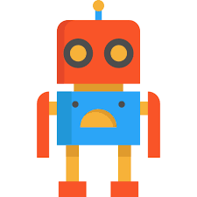
Time Based Revelations:
Resolving Human vs. AI Disagreement
Group 8
Shambhawi Pal - 5783763
Nicky Ju - 4856708
Simran Kaur - 5765269
Hrishita Chakrabarti - 5759048
Ee Xuan Tan - 4907531

Slide 2
Introduction
Peer disagreement in human-AI decision-making
Cooperation with AI & domain expert
Pursue common goal
Might lead to peer disagreement

Slide 3
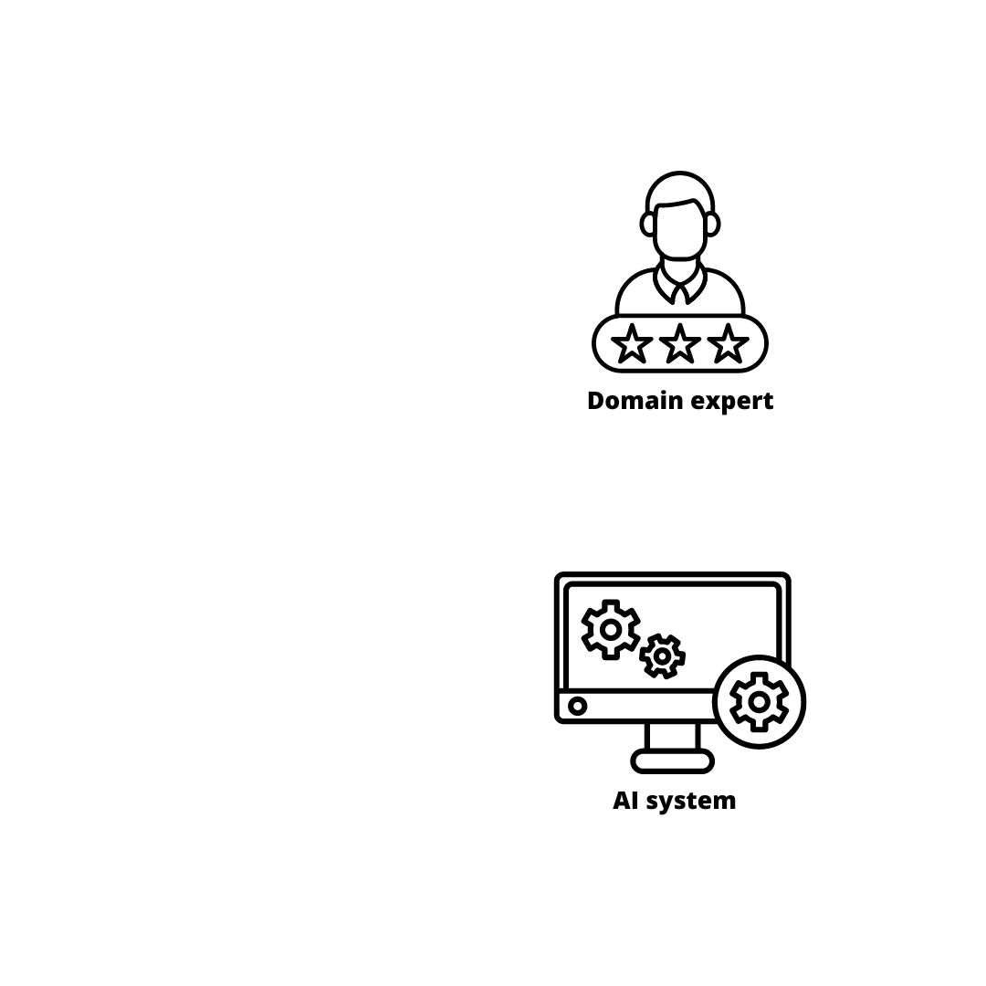
Project Context
Disagreement AI vs Domain expert
High risk/Low risk
Crowd Worker determines the final probability
Risk for a criminal to reoffend
Risk for someone to not be able to pay of loan

Slide 4
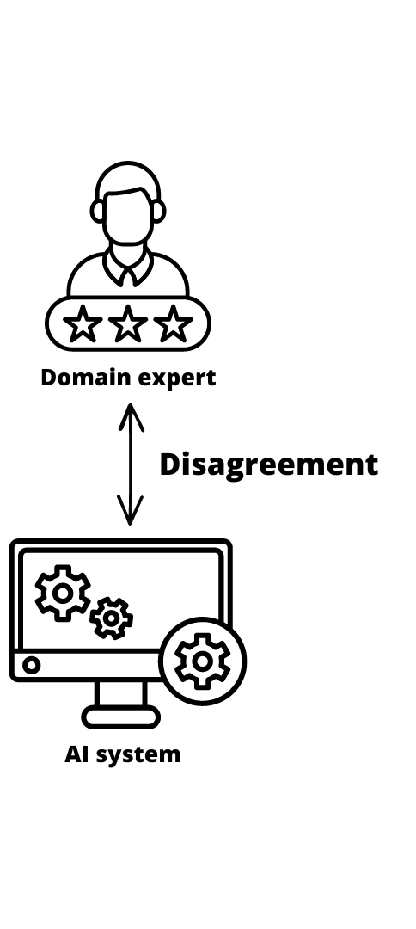
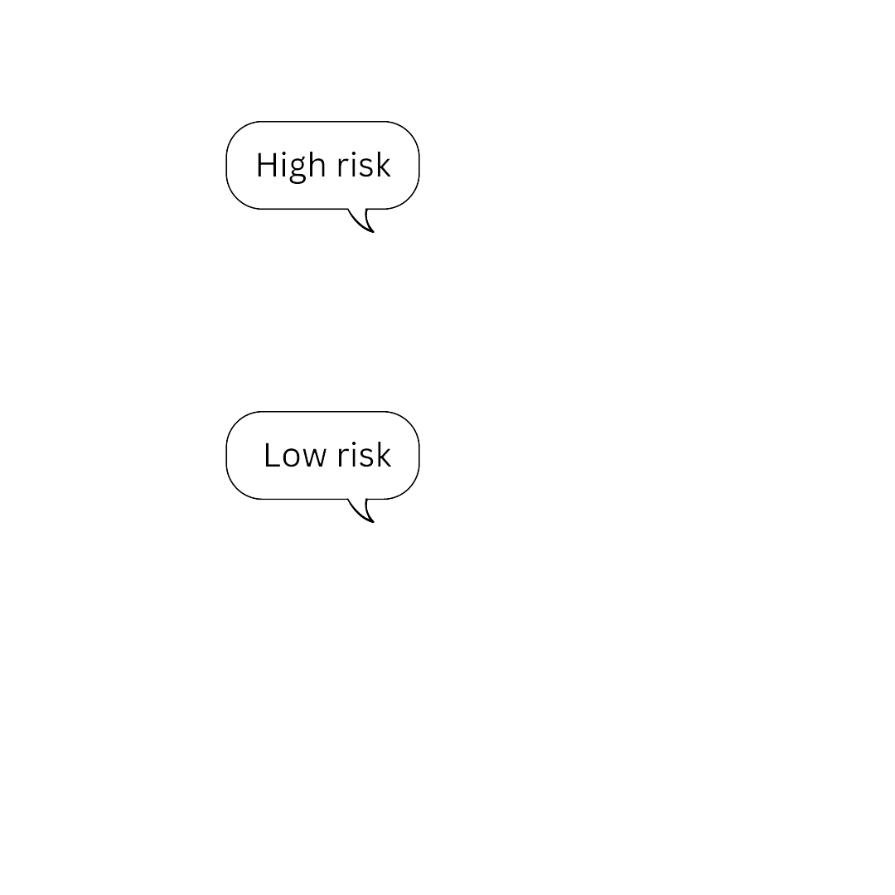
Project Context
Disagreement AI vs Domain expert
High risk/Low risk
Crowd Worker determines the final probability
Risk for a criminal to reoffend
Risk for someone to not be able to pay of loan

Slide 5
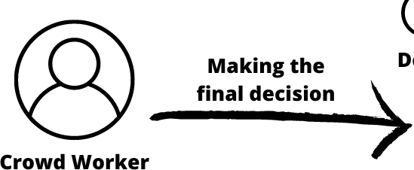
Project Context
Disagreement AI vs Domain expert
High risk/Low risk
Crowd Worker determines the final probability
Risk for a criminal to reoffend
Risk for someone to not be able to pay of loan

Slide 6
Datasets
Recidivism¹
Loan²
Name
Sex
Age
Race
Juvenile count
Priors count
Jail time
Crime
Employment title
Employment length
Annual income
Debt-to-income ratio
Loan purpose
Loan amount
Interest rate
Total credit lines
Open credit lines
Total credit limit
Total credit utilized
¹https://www.kaggle.com/datasets/danofer/compass
²https://www.kaggle.com/datasets/burak3ergun/loan-data-set

Slide 7

Related Works
Cognitive and Anchoring biases
Human-AI group Buçinca et al. (2021)
Human-Human group
Hartmann et al. (2020)
Reliance on AI
Overconfidence
Chiang et al. (2023)
Timing
Disclosure of rationale Park et al. (2019)
Disclosure identity of decision maker
Disclosure of decision
Fogliato et al. (2022)
Cognitive forcing functions
Buçinca et al. (2021)

Slide 8
Does the timing of revealing the profile of decision makers affect the human-made resolution of Human AI peer disagreement?
Notes:
Does the timing of revealing the profile of decision makers affect the human-made resolution of Human AI peer disagreement?

Slide 9
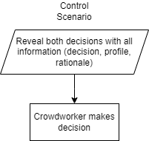
Control scenario:

Slide 10
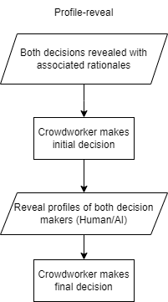
Experimental scenario:
Change the timing of disclosing decision-makers’ profiles

Slide 11
Hypothesis 1:
There will be a difference in decision when disclosing the profile of both decision-makers upfront compared to disclosing the profiles after an initial decision has been made.
Hypothesis 2:
There will be a difference in decision when disclosing the decisions without profiles compared to disclosing the rationales after with profiles.
Notes:
Base - disclose both profiles and rationales
Experimental - disclose both rationales → then disclose profiles
(Accuracy, reliance, confidence)
H1 - There will be a difference in disclosing the profile of both decision-makers up front when compared to disclosing the profiles after an initial decision has been made.
H2 - There will be a difference in decision when disclosing the decisions without profiles compared to disclosing the rationales after with profiles.
Hypothesis 1:
The average evaluation metric values for control is not equal to those values for experiment
Hypothesis 2:
The average evaluation metric value for experimental before is not equal those values for experimental after

Slide 12
Target Audience

Slide 13
Number of participants
G-power Analysis
Number of participants is 227 - effect size of 0.4
Effect size | Total sample size
0.25 | 506
0.3 | 352
0.4 | 200
0.5 | 128
Notes:
We looked into the number of participants for our experiment, we did this by conducting a G-power analysis. From there we measured the effect size and the nr of participants we needed for it to be statistically significant. Within the scope of the project, the budget given and keeping in mind a fair compensation for the crowd workers. We went with 227 participants, where this was split amongst 4 batches of control and experimental in the 2 contexts we explored. This means our effect size was 0.4.

Slide 14

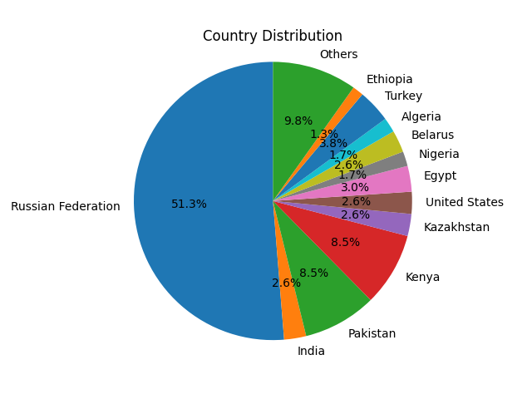
Target Audience
Intended Target Audience
Platform - Toloka English proficiency Aim to ensure diversity - Age, background, gender Offer fair compensation Recidivism - role of a jury Loan - preferably some financial knowledge
Resulting Audience
Platform - Toloka 227 Participants Compensated 7.2 dollars an hour
Notes:
Describe your targeted audience. Which are your target groups of users? How do
you accommodate their needs? How will you evaluate if their needs are met?

Slide 15
Worker Distribution
Number of workers per context and scenario (after attention check):
 | Experiment | Control | total (context wise)
loan | 58 | 44 | 102
recidivism | 63 | 62 | 125
total (scenario wise) | 121 | 106 | 227

Slide 16
Task Design

Slide 17
Rationales
Rational building
All rationales generated using ChatGPT[1]
ChatGPT was given the same information as displayed to the crowdworker and asked to justify each side of the disagreement
Rational evaluation
Opposing rationales evaluated for logical soundness
To ensure sound and similarly convincing arguments for both sides
Rationales were improved upon based on feedback received from evaluators
[1] (ChatGPT, personal communication, February 11, 2023)
Notes:
Firstly, through our datasets we could get the case profile information along with the risk assessment decision from two decision-makers but we had to build the rationales supporting those decisions. We used chatgpt to formulate the explanations by giving it the profile information and asking it to come up with arguments for both the decisions, and then reviewed them manually.
Further, we conducted a small evaluation of the rationales with a few people to ensure that they were logical and convincing, and also as per the feedback we got in the midterm to ensure that the rationales were non-distinguishable and didn’t reveal obvious patterns.

Slide 18
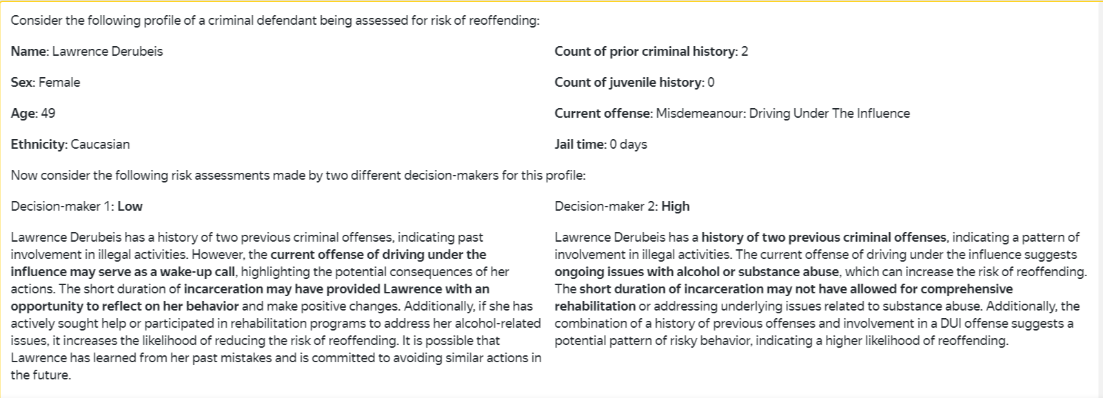
Task Design
Show profile of the case
Notes:
Then in our task as presented to the crowd worker we show the profile information

Slide 19
Task Design
Show decisions and rationales
Notes:
Then we show the two decisions side-by-side along with their rationales

Slide 20
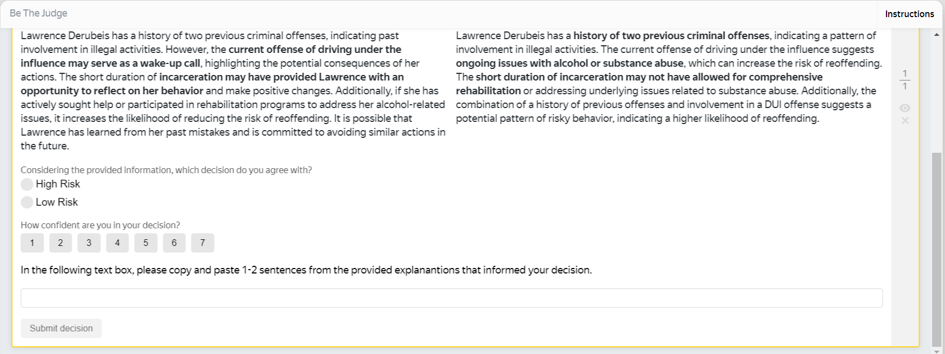
Task Design
Prompt for input
Notes:
And then prompt the crowd worker for their decision and how confident they are about it

Slide 21
Task Design
Attention check
Notes:
As an attention check, we also ask the crowd worker to provide an excerpt from the explanation for the decision that they chose to side with

Slide 22
Task Design
Reveal decision-maker profiles at different timings based on scenario (experimental / control)
Notes:
So that’s the basic idea of our task - but in order to test our hypotheses we needed two tasks which vary in terms of when the identity of the decision-maker is shown to the crowd worker based on the experimental or the control condition. So I’ll show the videos of the task workflow for each of them so it becomes clear how it was done.

Slide 23
Task Demonstration

Slide 24
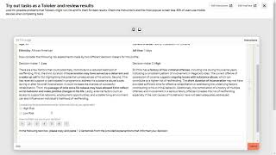
Experimental Task
Notes:
The crowd worker is asked to make a decision at first without seeing any information about the identity of the decision makers. Then it is revealed and they are again asked to make a decision.

Slide 25
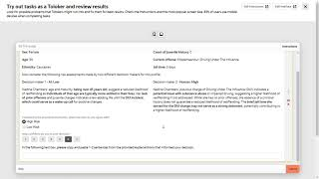
Control Task
Notes:
As opposed to that, in the control scenario the identity of the decision makers is revealed upfront along with all other information.

Slide 26
Task Deployment
Pilot testing
Determined the time it took to complete a task, then price based on hourly rate
Identified issues / glitches
Parameters
4 projects - 2 contexts, 2 scenarios For each project:
Overlap: 5 responses per case
Deployed in batches
Checked average response time after first batch, then updated price
Final cost / task:
Control task: $0.42
Experimental: $0.48
Notes:
In terms of how we deployed the task, we first performed a small pilot test to determine the task completion time and come up with a price for our task. Also, we had an overlap of 5 responses per case, we deployed the task in batches, and then based on the actual avg completion time for the first batch, we updated our task price a little.

Slide 27
Results

Slide 28
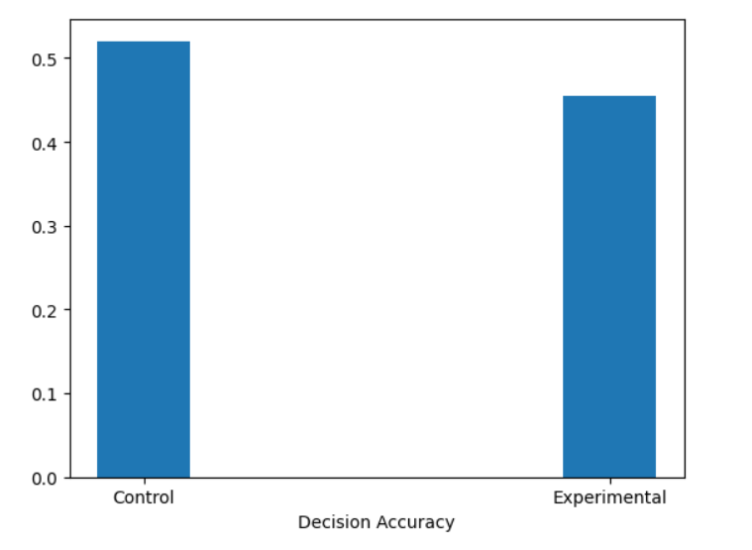
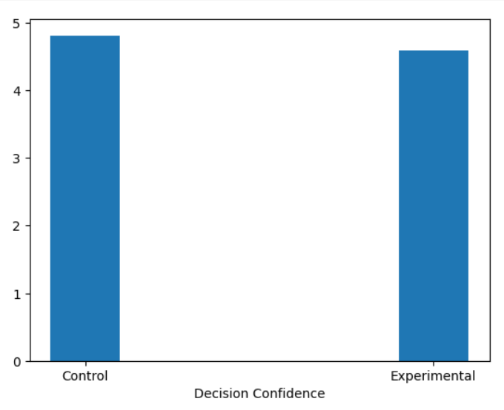
Results
Visualizing the results: For Hypothesis 1 Average decision accuracy and decision confidence across the scenarios
Observations
control accuracy was the higher than experiment
control confidence was higher than experiment
* Results were not significantly different for different contexts hence we present results aggregated over context

Slide 29
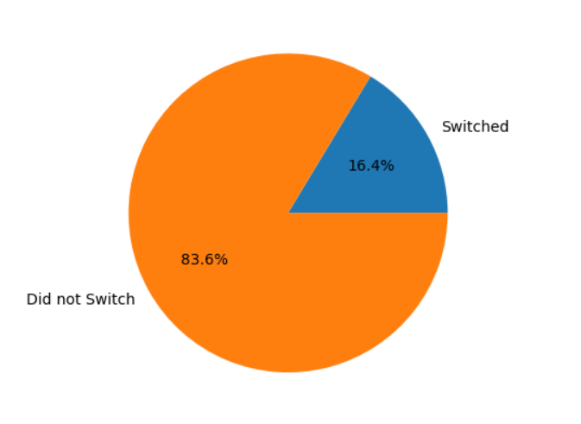
Results
Visualizing the results: For hypothesis 2 % people who switched their decisions
Observations:
very few people switched, out of those who did, they tended to switch to AI
Switch fractions:
Human -> AI: 0.134
AI -> Human: 0.125

Slide 30
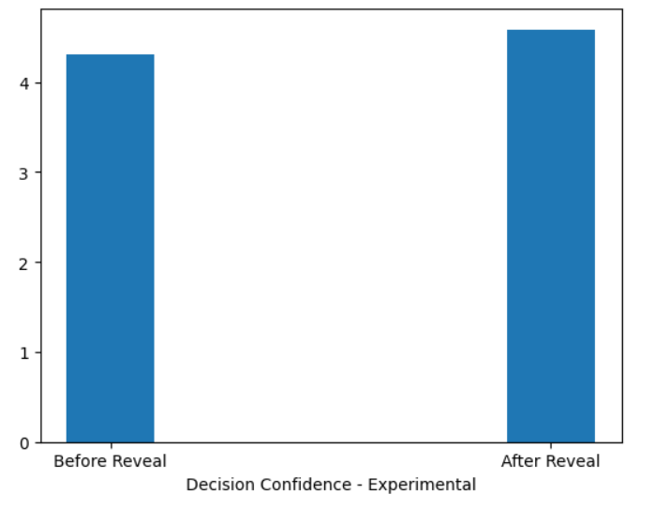
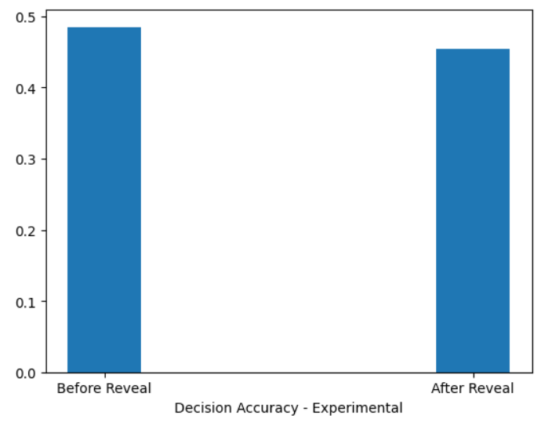
Results
Visualizing the results: For hypothesis 2 decision confidence and accuracy:
Observations:
Accuracy after switching to the AI decision was lower -> people perceived the AI to be more accurate than it really was
Confidence was higher for ‘after reveal’ which implies people were more confident about the AI's decision i.e they thought AI to be more competent than human which led to a fall in the overall accuracy

Slide 31
Evaluation
Metrics: Decision accuracy, Decision confidence, Switch Fraction
Hypothesis 1: two tailed T-test for metrics averaged over crowd worker
Hypothesis 2: two tailed paired T-test for metrics averaged over crowd worker
-

Slide 32
Reflection
Number of participants were less
No surprise effect for crowdworker
Notes:
The number of participants we took according to the G-power analysis was very less when we considered the effect size of 0.4. Most reliable results would be with the effect size 0.2 but due to project constraints wrt budget, we took into account the effect size of 0.4.
Based on the description of our tasks, the crowdworker already knew that one of the decision maker is AI and another one is human, and a major switch is not noticed even when the profiles are revealed later on. Therefore no surprise effect observed for crowdworker.

Slide 33
Reflection
Compelling explanations from both side: profile of the decision maker (human/AI) not evident)
AI Literacy: insufficient number of responses to form a conclusion
Notes:
At the beginning of the task, we also shared a survey in order to know the AI literacy of the crowdworker, however due to insufficient number of responses, we cannot come to conclusion whether AI data literacy of the worker impacts our system
In order to make the explanations indistinguishable such that worker cannot detect whether the decision was made by human or AI, we used chat GPT and the rationales from both the human and Ai became equally compelling. Thus the crowdworkers might have started thinking of Ai as equally competitive as human, thus leading to fall in accuracy.

Slide 34
Thanks!
We’re open for feedback & Q&A :)

